Slide 1
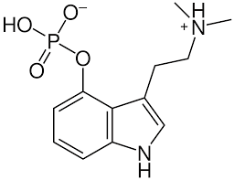
Psychedelic Assisted Therapy for Gambling Disorder
30th January 2023

Slide 2
Intro TO PSYCHEDELIC ASSISTED THERAPY ☺
Notes:
Psychoactive plants and fungi have been used for millennia for medicinal and religious purposes.
Originally a lot of psychedelic science was done in the ’50s and ’60s.
Psychedelics were showing promising results for addictions and mental health.
They were forbidden in the 70s.
A new wave of research has shown impressive results in the last decade.

Slide 3
Why research Psychedelic-Assisted Therapy (PAT) for Gambling Disorder?
Promising results in treating mental health disorders – Depression, Anxiety, Alcohol Abuse disorder, Substance use disorder, smoking cessation, PTSD, Anorexia, end-of-life anxiety, OCD…
High prevalence of Gambling Disorder (up to 5.8%)*, gambling-related harm and high relapse rates (up to 90%)**
1.4 million people in Britain are experiencing gambling harm.
Opportunity for ground-breaking research.
Notes:
The research is promising for hard-to-treat conditions: Treatment-resistant depression, eating disorders, substance use disorder, PTSD …
High prevalence of GD
Doing something that can have a great impact in the treatment of GD

Slide 4
Why research Psychedelic Assisted Therapy (PAT) for Gambling Disorder… CONTINUED
Access to collaboration with best-in-class researchers on Gambling Disorder and Psychedelics. A truly A team.
Positive media and social climate; all over the press and scientific media.
Regulators and jurisdictions are opening to new treatments.
FDA has granted Psilocybin and MDMA-assisted therapy breakthrough status.
Need for better treatment models. Make a real difference for people suffering from GD and their loved ones.
Notes:
Good connections with some of the best researchers.
Positive media.
The current treatments are just focusing on dealing with the symptoms.

Slide 5
What does PAT research look like?
Clinical assessment, psychological tests and interviews to ensure the suitability of the research subjects.
Preparation and objective setting of therapeutic sessions (3-6 sessions 90 minutes).
Psychedelic-assisted therapy sessions (2 sessions of 4-6 hours per session with 2 psychologists/therapists) – Some studies are trialling only one session with positive results.
Integration therapeutic sessions (3-6 sessions 90 minutes).
Analise data and publish research.
Notes:
Clinical assessment
Preparation sessions
Psychedelic sessions
Integration sessions
Analyse data.

Slide 6
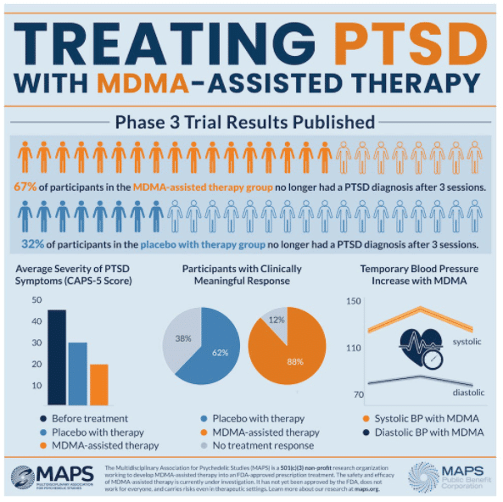
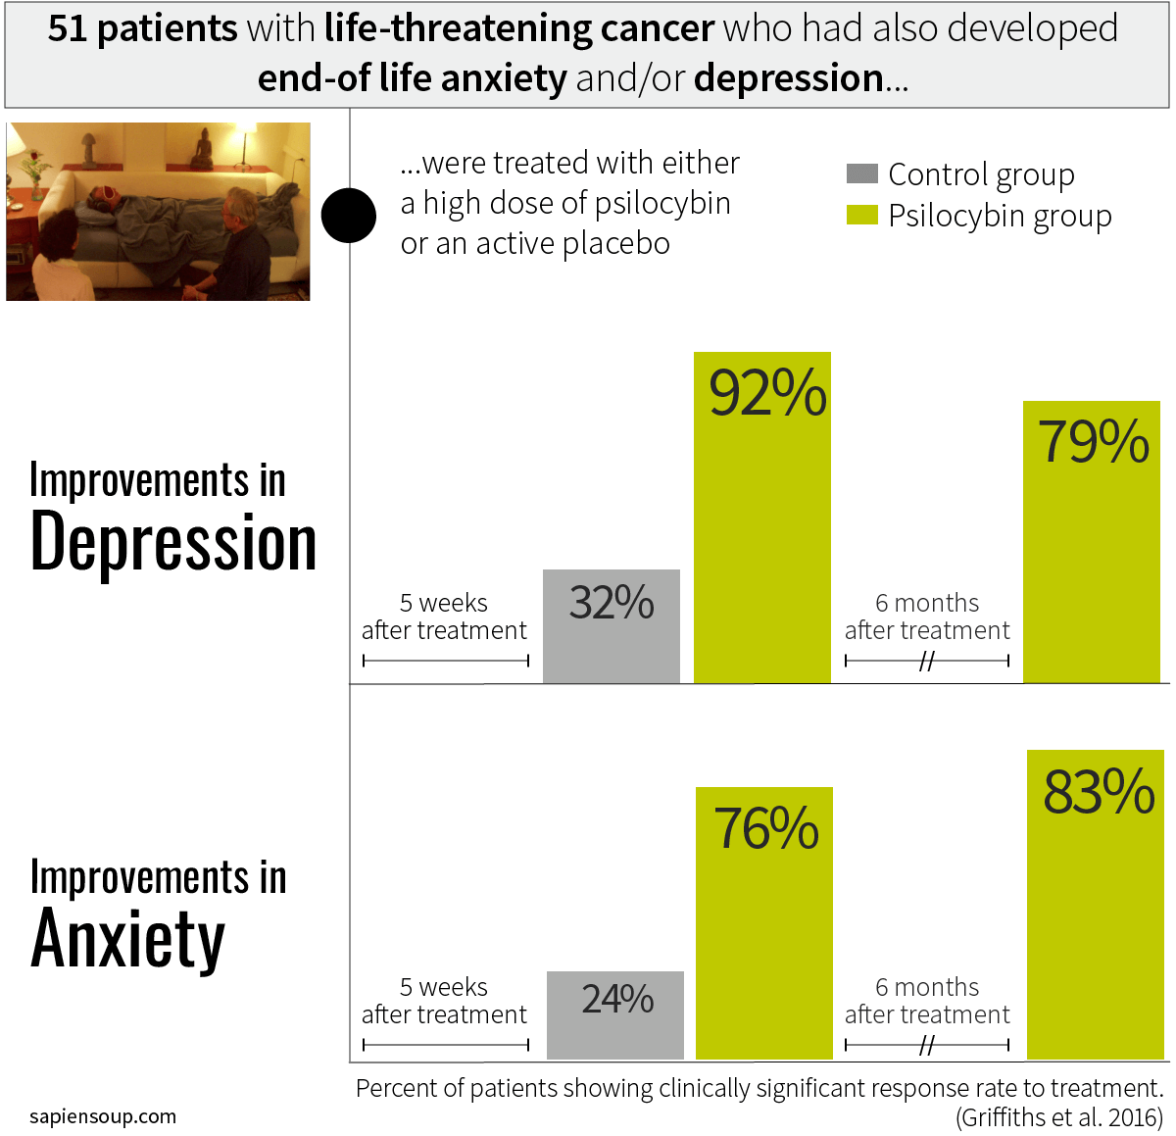
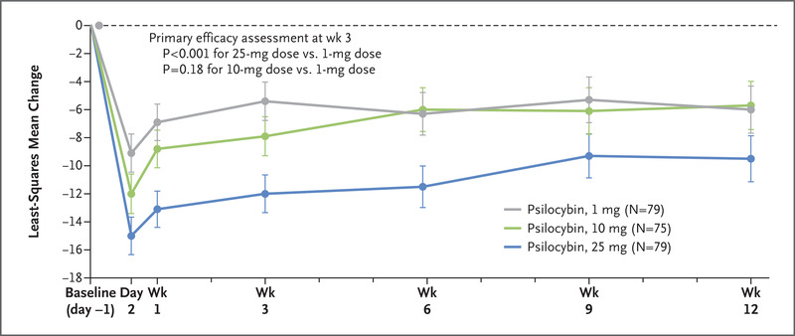
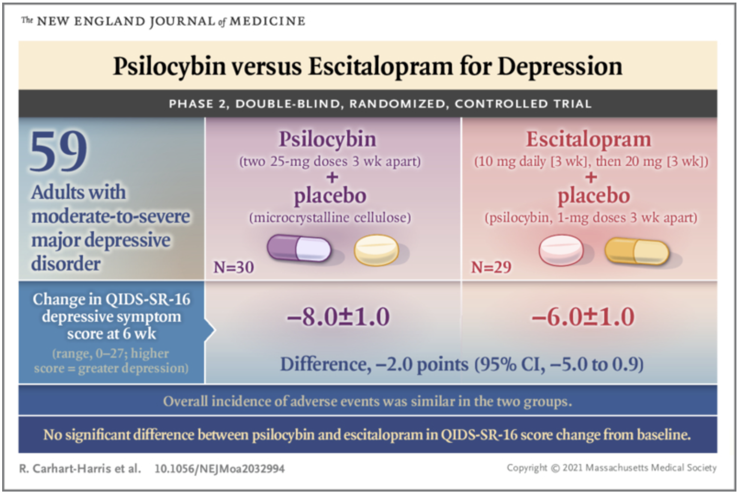
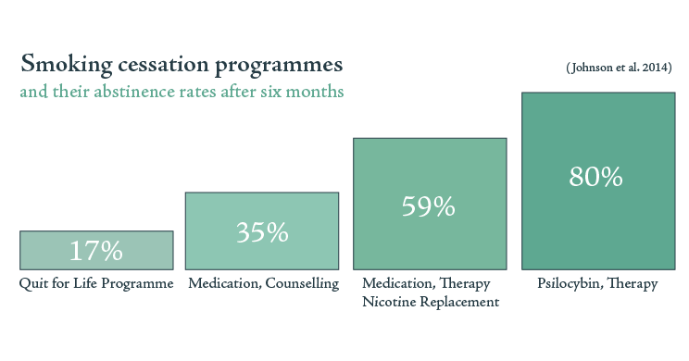
PAT Research is showing promising Results
Notes:
A single dose of psilocybin 1mg, 10mg, 25 mg Montgomery–Åsberg Depression Rating Scale (MADRS)
Life-threatening cancer end-of-life anxiety, 2 doses of medication and therapy.
MDMA-assisted therapy 3 doses for PTSD 67% recovered.
2 sessions reduced the percentage of days of heavy drinking.
Psilocybin vs Escitalopram RCT.
2 doses of psilocybin smoke cessation.

Slide 7
Current explanation on how psychedelic works?
Notes:
Alter the DMN allowing to process of information differently
Enabling break out of repetitive patterns of thinking.
Promotes active coping
Increases neuroplasticity
Emotional breakthrough

Slide 8
Open-label trial Psilocybin Assisted Therapy for GD
Sample: 10-12 participants
Hypothesis:
PAT has a positive effect on GD.
Inclusion Criteria:
Gambling Disorder - Treatment-resistant.
18 years old.
English speaker.
Healthy individuals - Medical check.
Exclusion Criteria
SSRI’s
Bipolar disorder.
History of Psychotic disorder or family member with Psychotic disorder.
Medical exclusions.
History of violent or suicidal behaviour.
Psychometric and
GD - PGSI & DSM 5
Anxiety - State-Trait Anxiety Inventory
Depression - Beck Depression /Montgomery-Åsberg Depression Rating Scale (MADRS)
Emotional Breakthrough Inventory (EBI)
Quick Inventory of Depressive Symptoms (QIDS)
Suicidality scale.
Hallucinogen Rating Scale and Mystical Experience Questionnaire 30
Five-Dimensional Altered States of Consciousness (5D-ASC)
Interviews
Phenomenological interviews.
Follow up
1 week, 5 weeks, 3 months and 6 months.

Slide 9
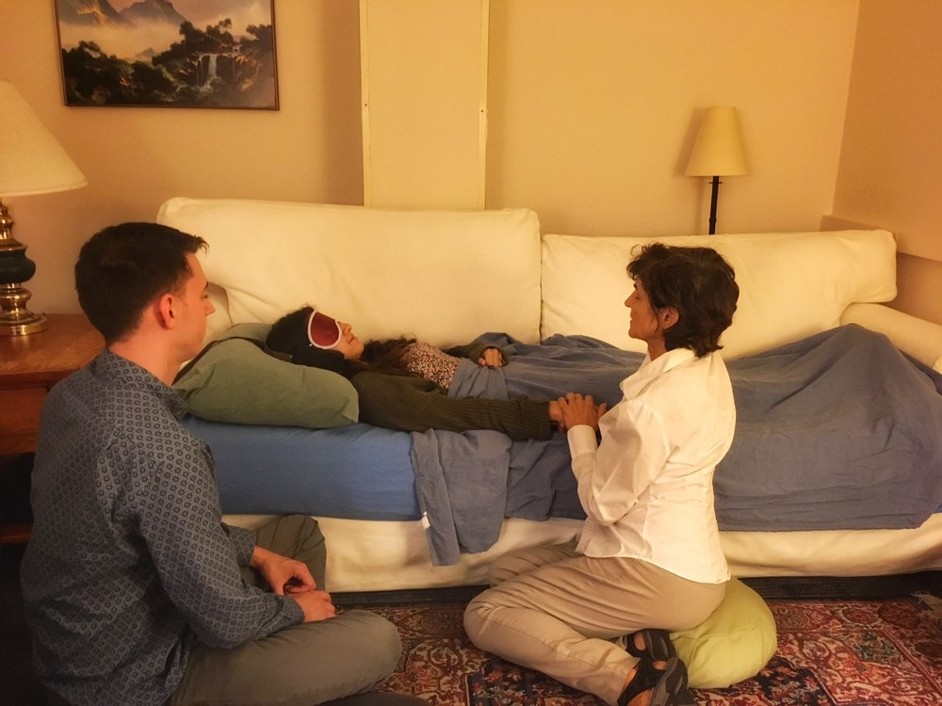
What is needed to proceed?
Approvals University Ethics /GHA/Customs.
Study participants 10-12.
Psilocybin molecule (Usona/Compass) or natural form.
2 Therapist / 1 Therapist 1 Sitter.
Setting. (Office with comfortable sofa).
Music and eyeshades.
Access to a GP/Nurse. In case an anxiolytic (Diazepam) is needed. Very Rare.
Notes:
Leo Zeff – A famous underground psychedelic therapist says that if the participant has anxiety during the session the therapist should take the diazepam ☺

Slide 10
Research questions
Is psychedelic-assisted therapy an effective treatment for gambling disorder?
Does psychedelic-assisted therapy have an impact decrease anxiety, depression, suicidality, and other related issues in people suffering from gambling disorder?
What is the prognosis after treatment?
What are the experiences of people affected by gambling disorder undergoing psychedelic-assisted therapy? (Phenomenological experience)
Is there potential to conduct RCT?
Notes:
1. Is effective?
2. Does it reduce comorbid symptoms?
3. How does it evolve after treatment?
4. Phenomenological experiences?
5. RCT

Slide 11
References
American Psychiatric Association, 2013. DSM-5 diagnostic classification. In: Diagnostic and Statistical Manual of Mental Disorders. https://doi.org/10.1176/appi. books.9780890425596.x00diagnosticclassification
Calado, F., & Griffiths, M. D. (2016). Problem gambling worldwide: An update and systematic review of empirical research (2000–2015). Journal of Behavioral Addictions. https://doi.org/10.1556/2006.5.2016.073
Mitchell, J. M., Bogenschutz, M., Lilienstein, A., Harrison, C., Kleiman, S., Parker-Guilbert, K., … Doblin, R. (2021). MDMA-assisted therapy for severe PTSD: a randomized, double-blind, placebo-controlled phase 3 study. Nature Medicine, 27(6).
Andersen, K. A. A., Carhart‐Harris, R., Nutt, D. J., & Erritzoe, D. (2021). Therapeutic effects of classic serotonergic psychedelics: A systematic review of modern‐era clinical studies. Acta Psychiatrica Scandinavica, 143(2), 101–118. https://doi.org/10.1111/acps.13249
Bayne, T., & Carter, O. (2018). Dimensions of consciousness and the psychedelic state. Neuroscience of Consciousness, 2018(1), niy008. https://doi.org/10.1093/nc/niy008
Bogenschutz, M. P., Ross, S., Bhatt, S., Baron, T., Forcehimes, A. A., Laska, E., Mennenga, S. E., O’Donnell, K., Owens, L. T., Podrebarac, S., Rotrosen, J., Tonigan, J. S., & Worth, L. (2022). Percentage of Heavy Drinking Days Following Psilocybin-Assisted Psychotherapy vs Placebo in the Treatment of Adult Patients With Alcohol Use Disorder: A Randomized Clinical Trial. JAMA Psychiatry, 79(10), 953. https://doi.org/10.1001/jamapsychiatry.2022.2096
Carhart-Harris, R. L. (2018). The entropic brain—Revisited. Neuropharmacology, 142, 167–178. https://doi.org/10.1016/j.neuropharm.2018.03.010
Carhart-Harris, R. L., Bolstridge, M., Rucker, J., Day, C. M. J., Erritzoe, D., Kaelen, M., Bloomfield, M., Rickard, J. A., Forbes, B., Feilding, A., Taylor, D., Pilling, S., Curran, V. H., & Nutt, D. J. (2016). Psilocybin with psychological support for treatment-resistant depression: An open-label feasibility study. The Lancet Psychiatry, 3(7), 619–627. https://doi.org/10.1016/S2215-0366(16)30065-7
Carhart-Harris, R. L., & Friston, K. J. (2019). REBUS and the Anarchic Brain: Toward a Unified Model of the Brain Action of Psychedelics. Pharmacological Reviews, 71(3), 316–344. https://doi.org/10.1124/pr.118.017160
Carhart-Harris, R. L., & Goodwin, G. M. (2017). The Therapeutic Potential of Psychedelic Drugs: Past, Present, and Future. Neuropsychopharmacology, 42(11), 2105–2113. https://doi.org/10.1038/npp.2017.84
Carhart-Harris, R., Leech, R., Hellyer, P., Shanahan, M., Feilding, A., Tagliazucchi, E., Chialvo, D., & Nutt, D. (2014). The entropic brain: A theory of conscious states informed by neuroimaging research with psychedelic drugs. Frontiers in Human Neuroscience, 8. https://www.frontiersin.org/articles/10.3389/fnhum.2014.00020
Carod-Artal, F. J. (2013). Psychoactive plants in ancient Greece.
Davis, A. K., Barrett, F. S., May, D. G., Cosimano, M. P., Sepeda, N. D., Johnson, M. W., Finan, P. H., & Griffiths, R. R. (2021). Effects of Psilocybin-Assisted Therapy on Major Depressive Disorder: A Randomized Clinical Trial. JAMA Psychiatry, 78(5), 481. https://doi.org/10.1001/jamapsychiatry.2020.3285
Daws, R. E., Timmermann, C., Giribaldi, B., Sexton, J. D., Wall, M. B., Erritzoe, D., Roseman, L., Nutt, D., & Carhart-Harris, R. (2022). Increased global integration in the brain after psilocybin therapy for depression. Nature Medicine, 28(4), Article 4. https://doi.org/10.1038/s41591-022-01744-z
de Vos, C. M. H., Mason, N. L., & Kuypers, K. P. C. (2021). Psychedelics and Neuroplasticity: A Systematic Review Unraveling the Biological Underpinnings of Psychedelics. Frontiers in Psychiatry, 12. https://www.frontiersin.org/articles/10.3389/fpsyt.2021.724606

Slide 12
References
Feduccia, A. A., Jerome, L., Yazar-Klosinski, B., Emerson, A., Mithoefer, M. C., & Doblin, R. (2019). Breakthrough for Trauma Treatment: Safety and Efficacy of MDMA-Assisted Psychotherapy Compared to Paroxetine and Sertraline. Frontiers in Psychiatry, 10, 650. https://doi.org/10.3389/fpsyt.2019.00650
Gasser, P., Kirchner, K., & Passie, T. (2015). LSD-assisted psychotherapy for anxiety associated with a life-threatening disease: A qualitative study of acute and sustained subjective effects. Journal of Psychopharmacology, 29(1), 57–68. https://doi.org/10.1177/0269881114555249
George, S., Ijeoma, O., & Bowden-Jones, H. (2013). Gamblers Anonymous: Overlooked and underused? Advances in Psychiatric Treatment, 19(1), 23–29. https://doi.org/10.1192/apt.bp.111.009332
Goodwin, G. M., Aaronson, S. T., Alvarez, O., Arden, P. C., Baker, A., Bennett, J. C., Bird, C., Blom, R. E., Brennan, C., Brusch, D., Burke, L., Campbell-Coker, K., Carhart-Harris, R., Cattell, J., Daniel, A., DeBattista, C., Dunlop, B. W., Eisen, K., Feifel, D., … Malievskaia, E. (2022). Single-Dose Psilocybin for a Treatment-Resistant Episode of Major Depression. New England Journal of Medicine, 387(18), 1637–1648. https://doi.org/10.1056/NEJMoa2206443
Griffiths, R. R., Johnson, M. W., Carducci, M. A., Umbricht, A., Richards, W. A., Richards, B. D., Cosimano, M. P., & Klinedinst, M. A. (2016). Psilocybin produces substantial and sustained decreases in depression and anxiety in patients with life-threatening cancer: A randomized double-blind trial. Journal of Psychopharmacology, 30(12), 1181–1197. https://doi.org/10.1177/0269881116675513
Grinspoon, L., & Bakalar, J. B. (1997). Psychedelic Drugs Reconsidered. Lindesmith Center. https://books.google.es/books?id=iOcePwAACAAJ
Grob, C. S., Danforth, A. L., Chopra, G. S., Hagerty, M., McKay, C. R., Halberstadt, A. L., & Greer, G. R. (2011). Pilot Study of Psilocybin Treatment for Anxiety in Patients With Advanced-Stage Cancer. Archives of General Psychiatry, 68(1), 71. https://doi.org/10.1001/archgenpsychiatry.2010.116
Hofmann, A. (2017). LSD, My Problem Child: Reflections on Sacred Drugs, Mysticism, and Science. MAPS, Multidisciplinary Association for Psychedelic Studies.
Johnson, M. W., Garcia-Romeu, A., Cosimano, M. P., & Griffiths, R. R. (2014). Pilot study of the 5-HT _{2A} R agonist psilocybin in the treatment of tobacco addiction. Journal of Psychopharmacology, 28(11), 983–992. https://doi.org/10.1177/0269881114548296
Kraus, S. W., Etuk, R., & Potenza, M. N. (2020). Current pharmacotherapy for gambling disorder: A systematic review. Expert Opinion on Pharmacotherapy, 21(3), 287–296. https://doi.org/10.1080/14656566.2019.1702969
Mitchell, J. M., Bogenschutz, M., Lilienstein, A., Harrison, C., Kleiman, S., Parker-Guilbert, K., Ot’alora G., M., Garas, W., Paleos, C., Gorman, I., Nicholas, C., Mithoefer, M., Carlin, S., Poulter, B., Mithoefer, A., Quevedo, S., Wells, G., Klaire, S. S., van der Kolk, B., … Doblin, R. (2021). MDMA-assisted therapy for severe PTSD: A randomized, double-blind, placebo-controlled phase 3 study. Nature Medicine, 27(6), Article 6. https://doi.org/10.1038/s41591-021-01336-3
Ross, S., Bossis, A., Guss, J., Agin-Liebes, G., Malone, T., Cohen, B., Mennenga, S. E., Belser, A., Kalliontzi, K., Babb, J., Su, Z., Corby, P., & Schmidt, B. L. (2016). Rapid and sustained symptom reduction following psilocybin treatment for anxiety and depression in patients with life-threatening cancer: A randomized controlled trial. Journal of Psychopharmacology, 30(12), 1165–1180. https://doi.org/10.1177/0269881116675512
Samorini, G. (2019). The oldest archeological data evidencing the relationship of Homo sapiens with psychoactive plants: A worldwide overview. Journal of Psychedelic Studies, 3(2), 63–80. https://doi.org/10.1556/2054.2019.008
Schlag, A. K., Aday, J., Salam, I., Neill, J. C., & Nutt, D. J. (2022). Adverse effects of psychedelics: From anecdotes and misinformation to systematic science. Journal of Psychopharmacology, 36(3), 258–272. https://doi.org/10.1177/02698811211069100
Schultes, R. E., Hofmann, A., & Rätsch, C. (2001). Plants of the Gods: Their Sacred, Healing, and Hallucinogenic Powers. Inner Traditions/Bear.
von Rotz, R., Schindowski, E. M., Jungwirth, J., Schuldt, A., Rieser, N. M., Zahoranszky, K., Seifritz, E., Nowak, A., Nowak, P., Jäncke, L., Preller, K. H., & Vollenweider, F. X. (2023). Single-dose psilocybin-assisted therapy in major depressive disorder: A placebo-controlled, double-blind, randomised clinical trial. EClinicalMedicine, 56, 101809. https://doi.org/10.1016/j.eclinm.2022.101809
WHO. (2022). Tobacco. https://www.who.int/news-room/fact-sheets/detail/tobacco

Slide 13
THANK YOU FOR YOUR ATTENTION
Q & A
https://www.unigib.edu.gi/cerg

