Slide 1
Achieving efficiency in large-scale digitization project management with free IT tools
An inspirational talk about task management and team motivation
MARINA GEORGIEVA
ALA Annual 2018
Ernest Morial Convention Center
New Orleans, LA
June 23, 2018

Slide 2
Choosing the right product
CONSIDER THE PROJECT
MANAGERIAL PERSPECTIVE
COLLABORATORS PERSPECTIVE
Project complexity
Workload segmentation
Parallel workflows
Simultaneous batches
Project contributors
Number of people involved
Contributors’ expertise and tasks
Project management
Managing parallel projects
Tracking progress
Setting deadlines
File sharing
Team management
Easy-to-train
Task granulation
Managing checklists
Individual/group tasks
Simultaneous collaboration
Easy-to-use
Tracking other team members’ progress
Commenting and file sharing
Easy updates
Easy editing
Flexibility
Syncs with mobile apps
Notes:
- Using the right project management tool definitely boosts productivity and increases efficiency.
- 3 areas to consider when selecting a tool.
- Users perspective is important – the tool need to make users feel connected to the project and motivate them to contribute to it.
- The right app makes users crave collaboration instead of dreading it.

Slide 3
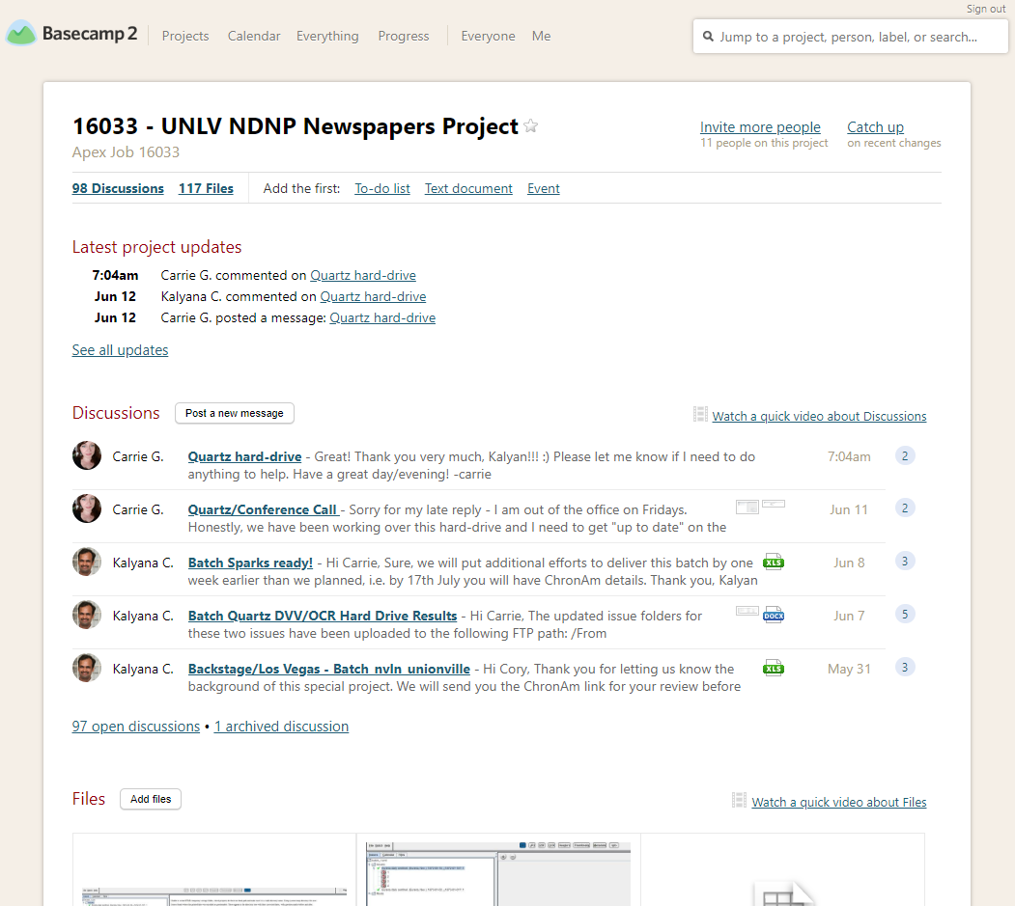
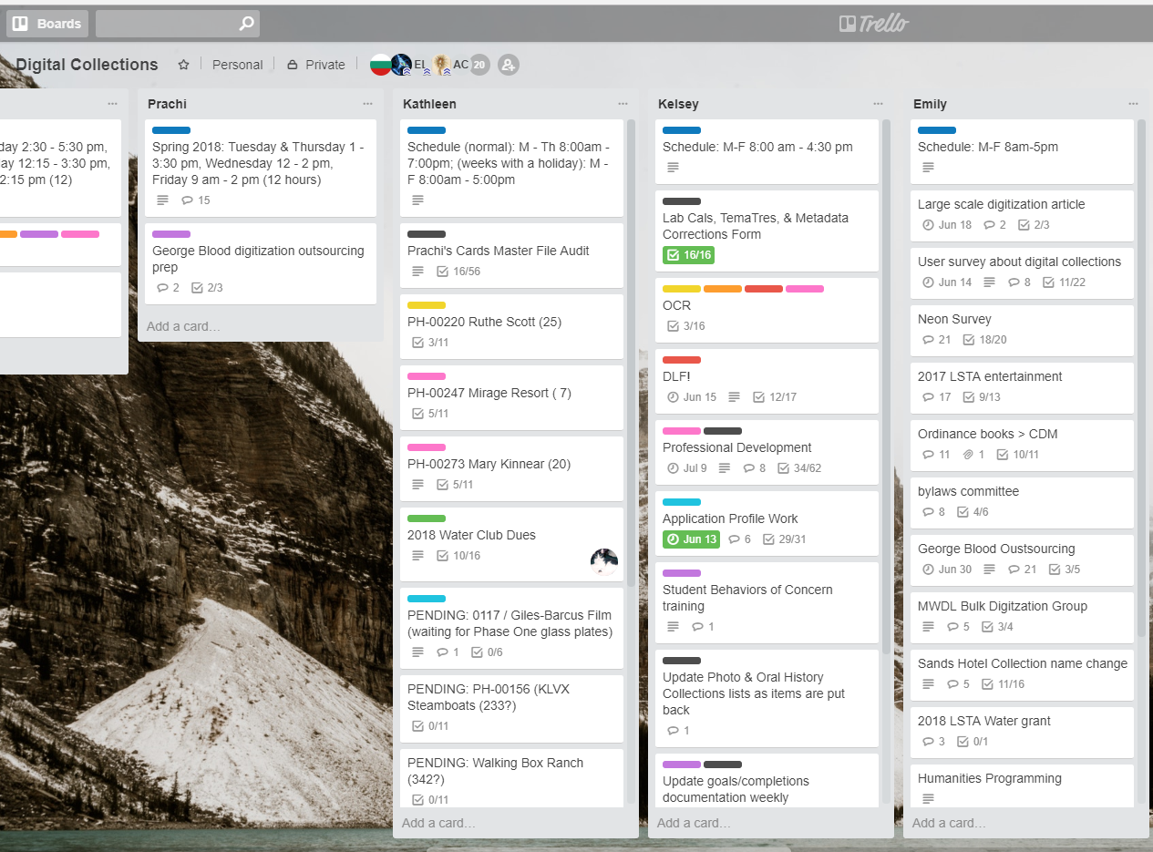
Basecamp vs. Trello | overview
Notes:
Basecamp – simple layout, fewer features, central email repository, no flexibility of structuring content
Trello – more sophisticated, more options, highly customizable, easy-to-use and rearrange content
Searching – both support keyword searching; Trello has filtering feature for higher precision

Slide 4
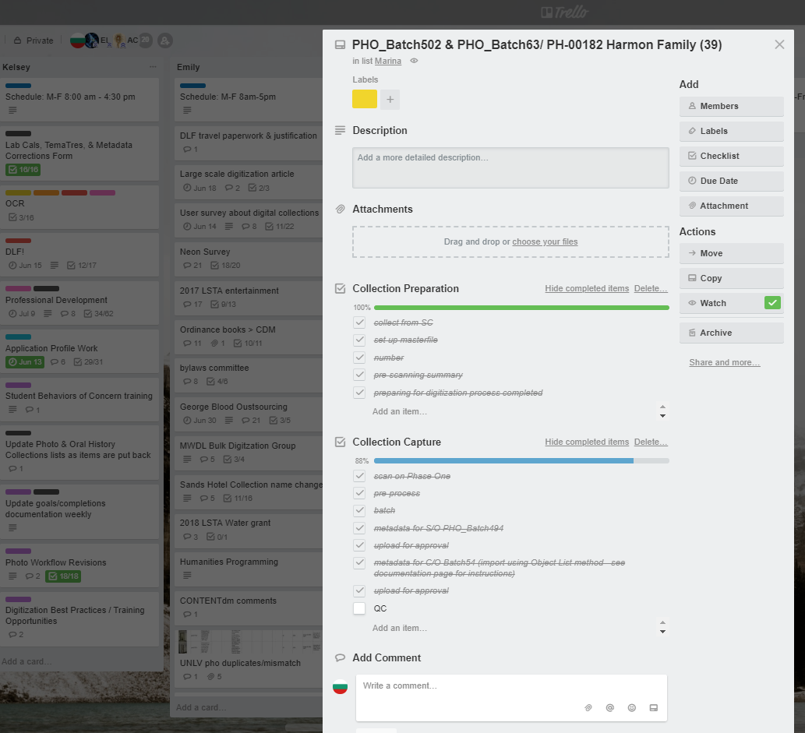
Basecamp vs. Trello | features
LISTS
CARD
MAIN FEATURES
- Calendar
- Updates
- Checklists (to-do lists)
- Latest discussion threads
- Shared files
- Custom tags (files only)
- Catch up
MAIN FEATURES
- Lists | cards | checklists
- Commenting in card
- Shared files
- Color-coding; tagging
- Card filtration
- Multiple widgets
Notes:
Emphasis on Trello’s progress monitoring, making everyone connected, ease of use and reassigning tasks!
Emphasis on Basecamp’s chronological arrangement

Slide 5
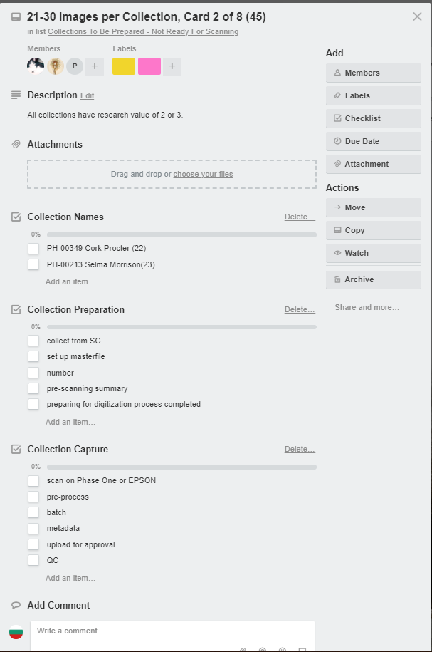
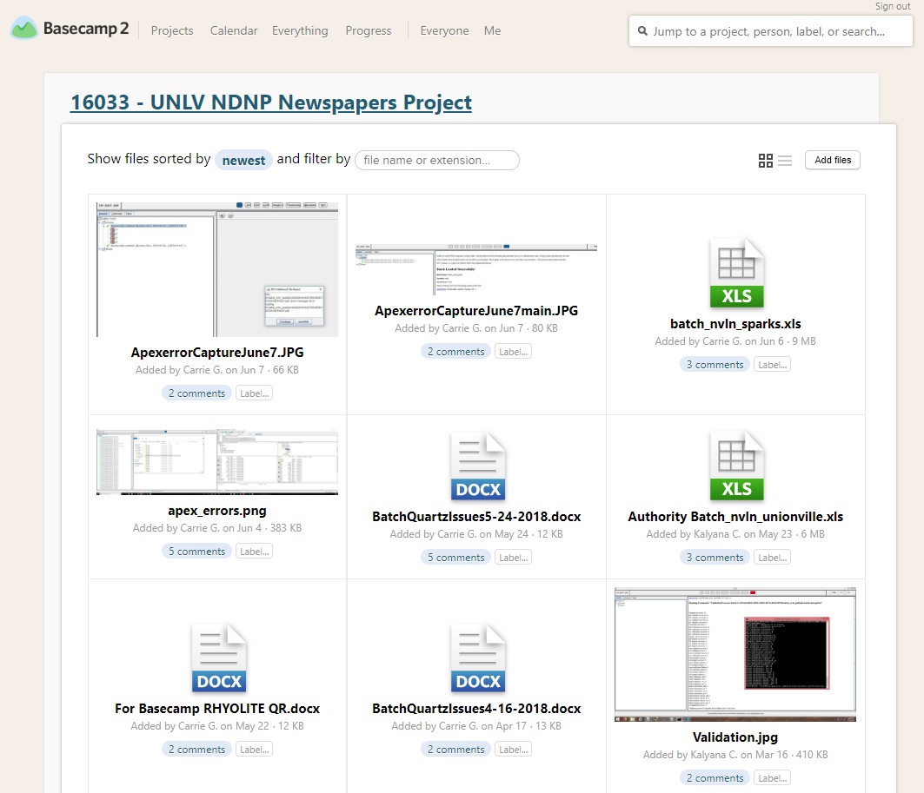
Basecamp vs. Trello | recommended for
BEST FOR
- Task granulation
- Progress tracking
- Assigning task to several people
- Collaboration
- Due dates
- Privacy settings
BEST FOR
- Sharing multiple large files
- Record-keeping (no edits)

Slide 6
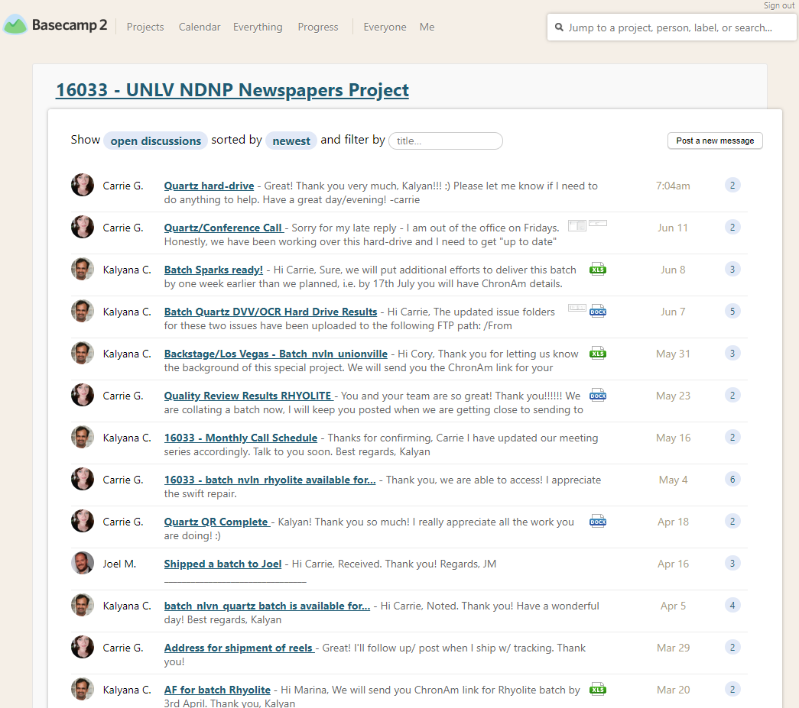
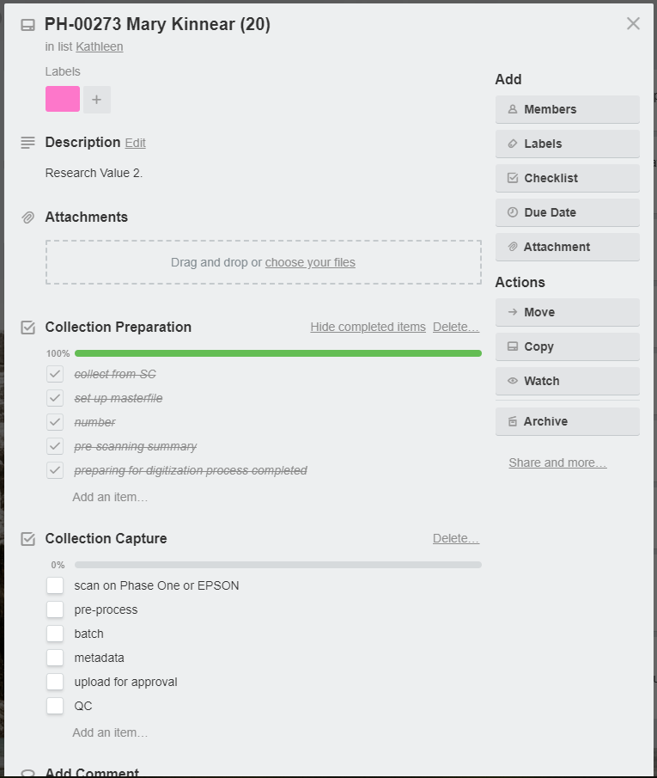
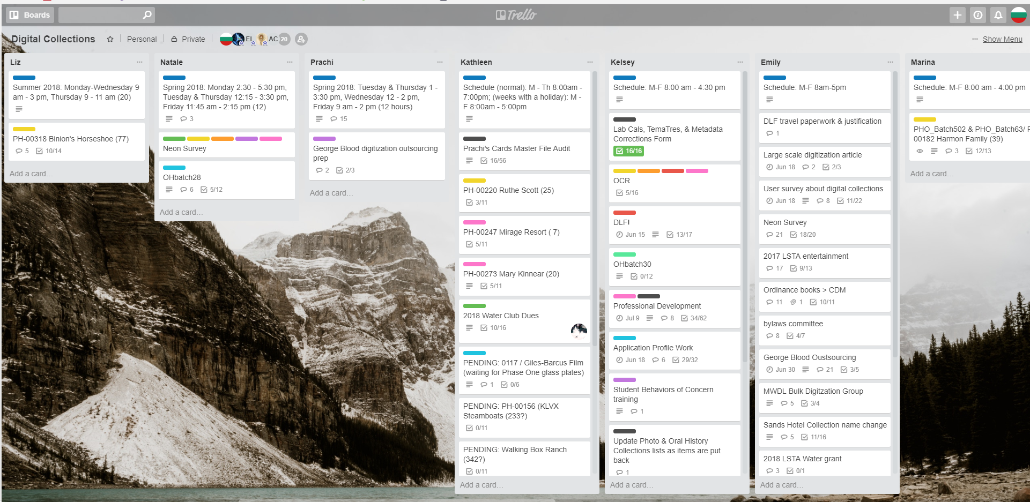
Basecamp vs. Trello | shortcomings
SHORTCOMINGS
- No calendar (free version)
- Layout may get overwhelming
- Customization may take much time
- Hit “save” (enter key doesn’t work)
SHORTCOMINGS
- No customization
- No content organization
- Fewer widgets
- Fewer features
- No flexibility
- Chronological arrangement of content
- Difficult browsing | keyword search

Slide 7
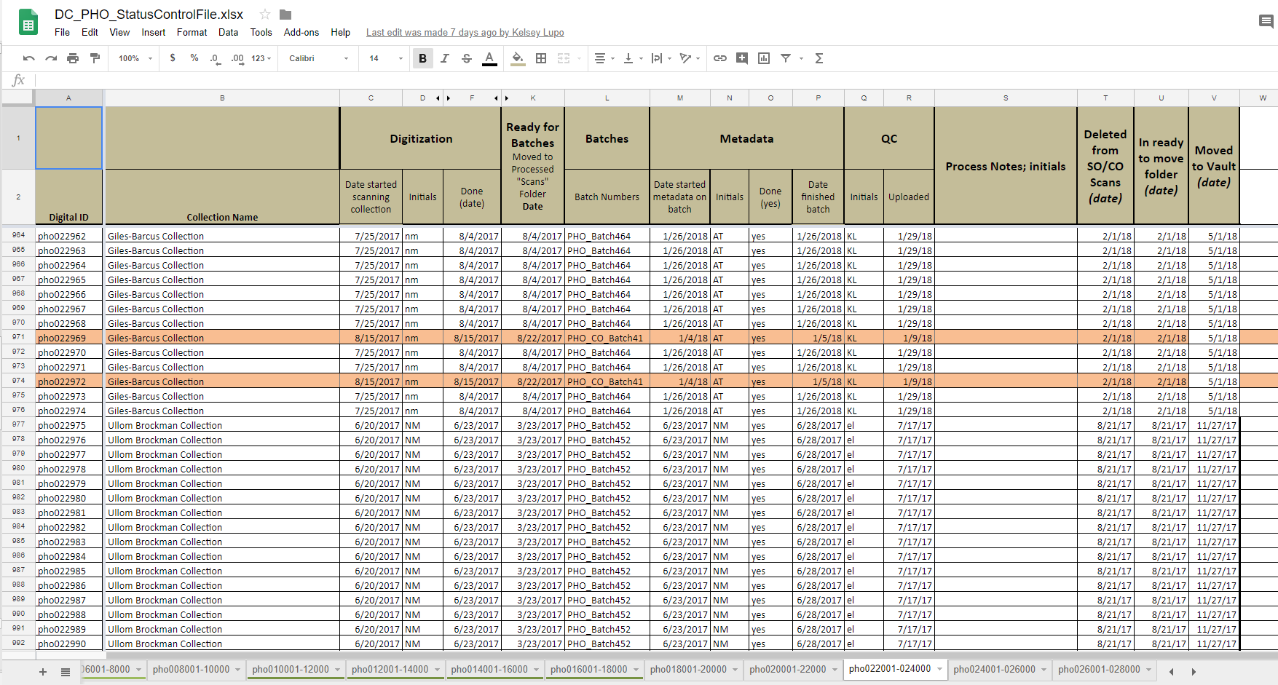
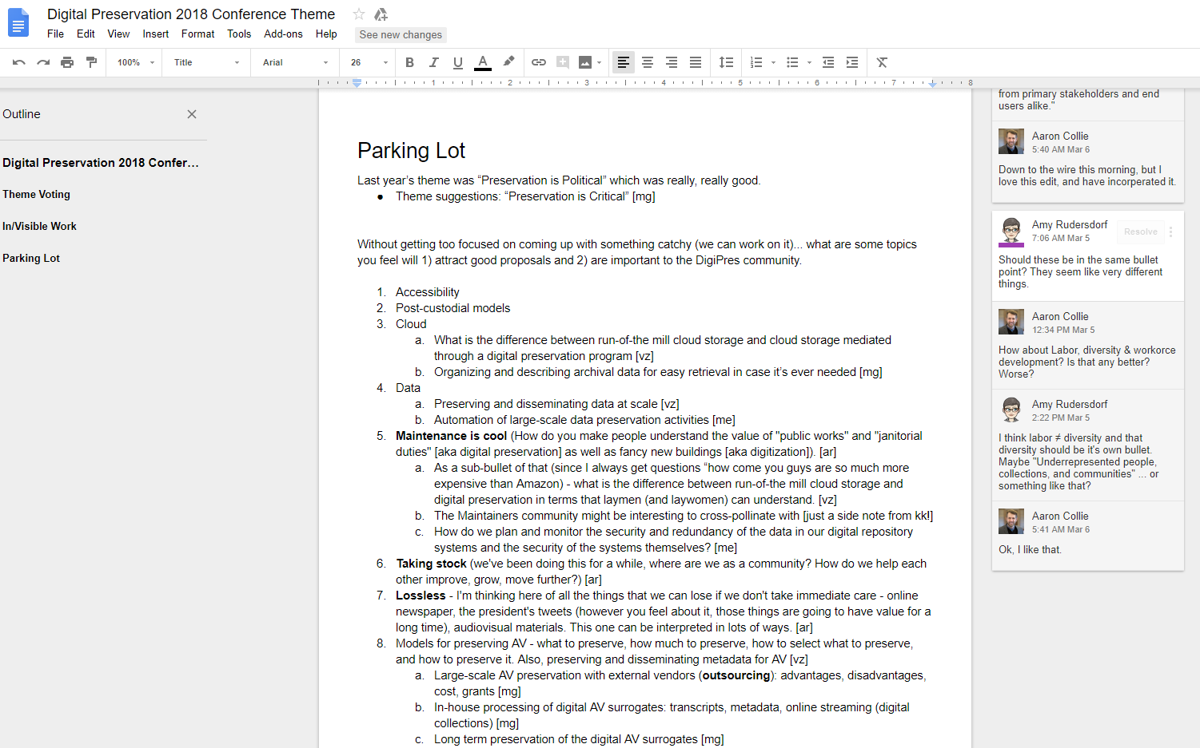
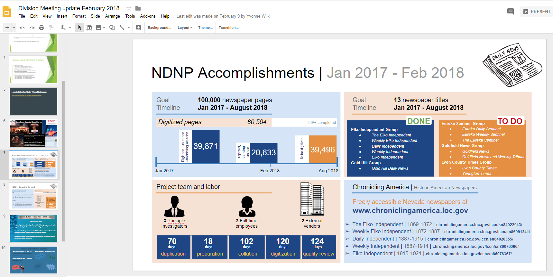
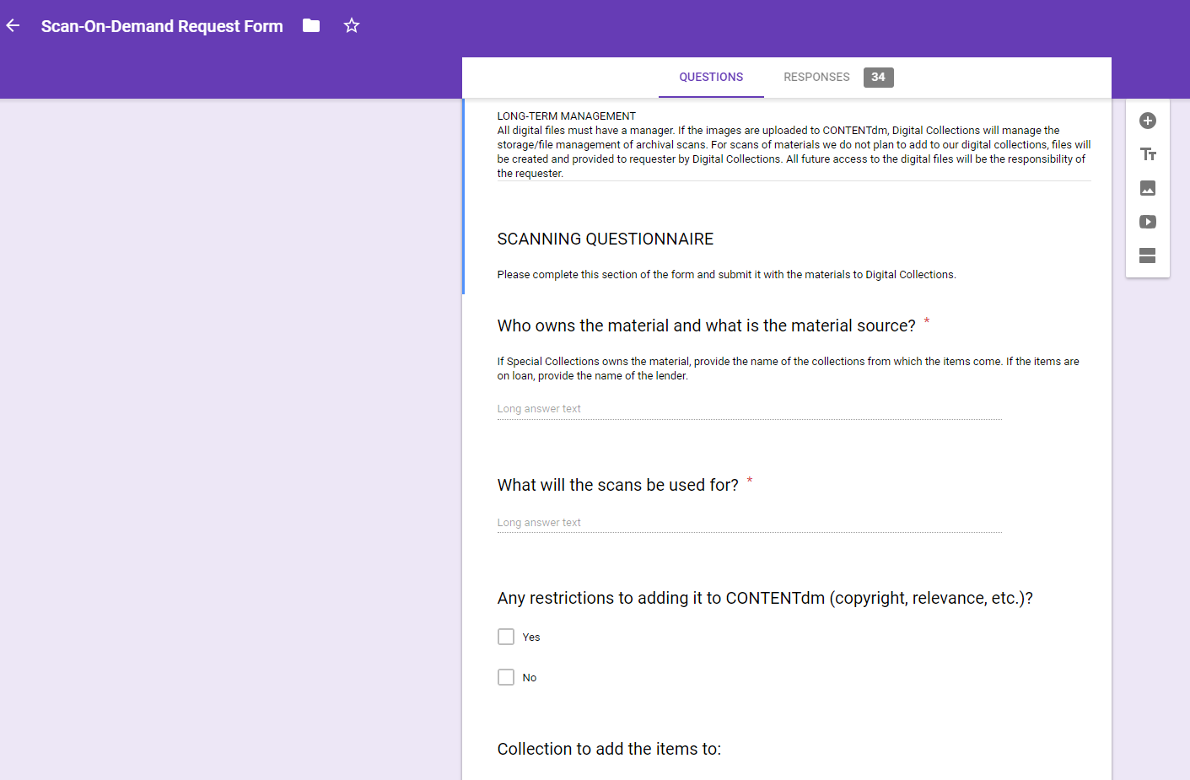
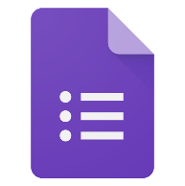
cloud suite
Great for
- Simultaneous collaboration
- Tracking progress
- Sharing and setting permissions
Pros
- Syncs with mobile apps
- Easy to use and share
- Basic version control
- Easy access
- Central placeholder
- Search feature
- Automatic save / file update
Cons
- Limited formatting features
- Accessibility / Internet connection
sheets
docs
slides
forms

Slide 8
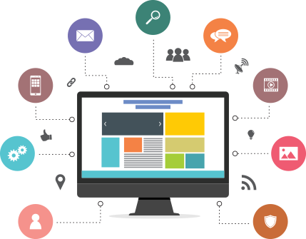
Final thoughts
Benefits of using the right app
Increases productivity
Increases efficiency
Improves collaboration
Brings high morale
Makes team crave collaboration
How to get started?
Review products
Ask around for recommendation
Try it!
Change it if it’s not a good fit
Share your experience
Remember, each project and each team is different. There’s nothing like one size fits all.
Remain flexible, experiment, switch products.
Assess your needs and select the product that fits best your current needs. This may change in the future and that’s ok.
Flexibility and frequent assessment is your best bet for increased efficiency and boosted productivity!
Notes:
We just scratched the surface.
Consider a tool that will boost your team’s morale and productivity; so helpful that will make them happy and craving collaboration.

Slide 9
Thank you!
Visiting Digital Collections Librarian
University of Nevada - Las Vegas
University Libraries
4505 S Maryland Parkway
Box 457041
Las Vegas, NV 89154
Tel: 702-895-2310
marina.georgeiva@unlv.edu
orcid.org/0000-0002-2134-6719
www.marina-expertise.com
COLLABORATIVE TOOLS
g-drive
sheets
docs
slides
forms

